Slide 1
Welcome to the WGU Webinar:
Homeschooling Children with Special Needs
Finding Your Child’s Superpower
You should be hearing music. If not, please adjust your audio.
The webinar will begin in:
15
Minutes

Slide 2
Welcome to the WGU Webinar:
Homeschooling Children with Special Needs
Finding Your Child’s Superpower
You should be hearing music. If not, please adjust your audio.
The webinar will begin in:
14
Minutes

Slide 3
Welcome to the WGU Webinar:
Homeschooling Children with Special Needs
Finding Your Child’s Superpower
You should be hearing music. If not, please adjust your audio.
The webinar will begin in:
13
Minutes

Slide 4
Welcome to the WGU Webinar:
Homeschooling Children with Special Needs
Finding Your Child’s Superpower
You should be hearing music. If not, please adjust your audio.
The webinar will begin in:
12
Minutes

Slide 5
Welcome to the WGU Webinar:
Homeschooling Children with Special Needs
Finding Your Child’s Superpower
You should be hearing music. If not, please adjust your audio.
The webinar will begin in:
11
Minutes

Slide 6
Welcome to the WGU Webinar:
Homeschooling Children with Special Needs
Finding Your Child’s Superpower
You should be hearing music. If not, please adjust your audio.
The webinar will begin in:
10
Minutes

Slide 7
Welcome to the WGU Webinar:
Homeschooling Children with Special Needs
Finding Your Child’s Superpower
You should be hearing music. If not, please adjust your audio.
The webinar will begin in:
9
Minutes

Slide 8
Welcome to the WGU Webinar:
Homeschooling Children with Special Needs
Finding Your Child’s Superpower
You should be hearing music. If not, please adjust your audio.
The webinar will begin in:
8
Minutes

Slide 9
Welcome to the WGU Webinar:
Homeschooling Children with Special Needs
Finding Your Child’s Superpower
You should be hearing music. If not, please adjust your audio.
The webinar will begin in:
7
Minutes

Slide 10
Welcome to the WGU Webinar:
Homeschooling Children with Special Needs
Finding Your Child’s Superpower
You should be hearing music. If not, please adjust your audio.
The webinar will begin in:
6
Minutes

Slide 11
Welcome to the WGU Webinar:
Homeschooling Children with Special Needs
Finding Your Child’s Superpower
You should be hearing music. If not, please adjust your audio.
The webinar will begin in:
5
Minutes

Slide 12
Welcome to the WGU Webinar:
Homeschooling Children with Special Needs
Finding Your Child’s Superpower
You should be hearing music. If not, please adjust your audio.
The webinar will begin in:
4
Minutes

Slide 13
Welcome to the WGU Webinar:
Homeschooling Children with Special Needs
Finding Your Child’s Superpower
You should be hearing music. If not, please adjust your audio.
The webinar will begin in:
3
Minutes

Slide 14
Welcome to the WGU Webinar:
Homeschooling Children with Special Needs
Finding Your Child’s Superpower
You should be hearing music. If not, please adjust your audio.
The webinar will begin in:
2
Minutes

Slide 15
Welcome to the WGU Webinar:
Homeschooling Children with Special Needs
Finding Your Child’s Superpower
You should be hearing music. If not, please adjust your audio.
The webinar will begin in:
1
Minute

Slide 16
Homeschooling Children with Special Needs
Finding Your Child’s Superpower
Presented by: Kim DeMent and Sunny Jordan
Notes:
Good morning everyone and good afternoon to those of you on the East Coast. My name is Julie Hernandez and I am WGU’s Educational and Professional programming manager. I will be today’s host and as such I want to Welcome to this month’s four-part webinar series.
Today’s topic is ….
But first….

Slide 17
Etiquette
Etiquette:
Please mute your microphone.
Type your questions into the chat. We’ll answer questions during the Q&A.
We’ll answer questions during the Q&A
Notes:
Some basic etiquette guidelines. You have all been muted upon entry. If you have a questions you can type t into the chat, indicated by a thought bubble at the bottom of your screen. Or you can enter it into the Q&A. You’ll find that by clicking on the 3 dots and selecting Q&A from the menu.
As an overview of what to expect during the next 45 minutes. Two slides about WGU for those of you who are unfamiliar with our university.
Each of our panelists will introduce themselves as they present their roles and learnings.
We’ve prepared three questions that I will pose to the panelists about what they’ve learned
And then we will open up to questions which I will read to the panelists from the chat and Q&A.
This webinar is being recorded and will be posted on our website, along with the PowerPoint presentation by Monday.

Slide 18
About Our Students
121K
73%
92%
*
students
enrolled
have full-time jobs
are 25 or older
* Student enrollment nationwide in WGU as of [2/29/20].
Notes:
A little about WGU and our students. WGU is just a little over twenty years old. Having been founded by a group of Governors in the Western States, thus our name. to provide access to higher education to meet workforce needs in the present and the future. We serve a nontraditional population through our online and competency based approach to higher education. 73% of our students have full-time jobs and 92% are 25 or older.

Slide 19
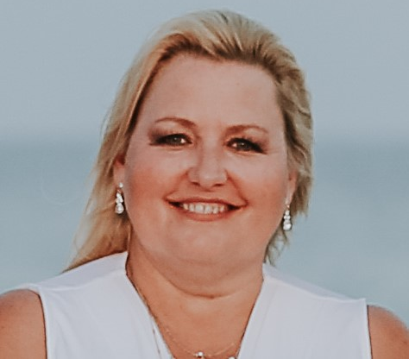
About your presenters
Kim DeMent
Sunny Jordan
Director of Advanced Programs Teachers College
Strategic Partnership Manager
WGU North Carolina
Notes:
Julie Hernandez will introduce each of you with these words:

Slide 20
Webinar Series
Agenda:
Our stories
Benefits to Homeschooling Special Needs Children
Curriculum
IEPs
Empowering and Believing in Them and You
Resources
Q&A
Notes:
Kim
As an overview of what to expect during the next 45 minutes.

Slide 21
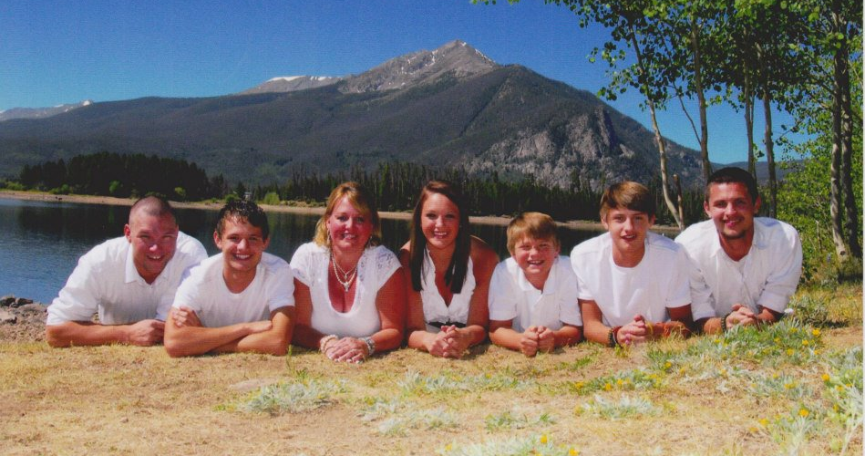
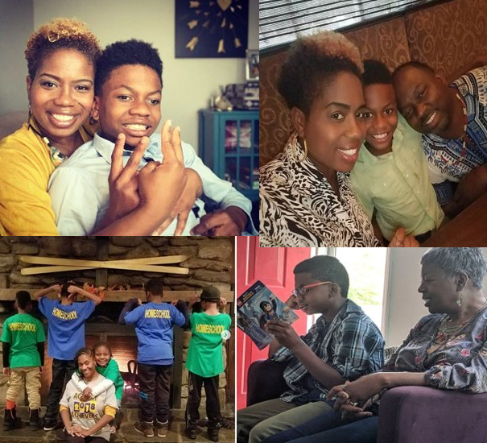
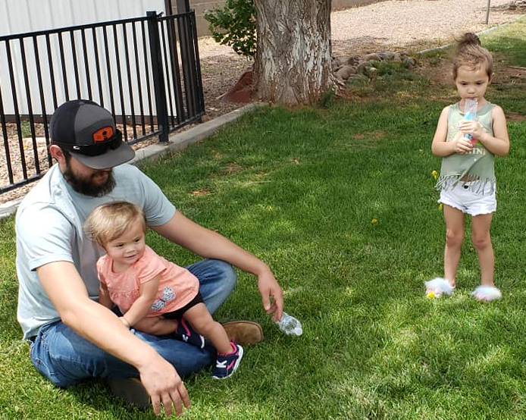
Our Stories
It takes a village.....
Notes:
Family
Why we homeschool?

Slide 22
Do you know your child's Superpower?
​1. Yes, I have discovered my child(s) super-power
2. No, I wish to learn how to discover
3. Possibly, but open to learning more
Notes:
Sunny

Slide 23
Is special needs homeschooling Possible?
Yes, You Can!!!
Notes:
Sunny

Slide 24
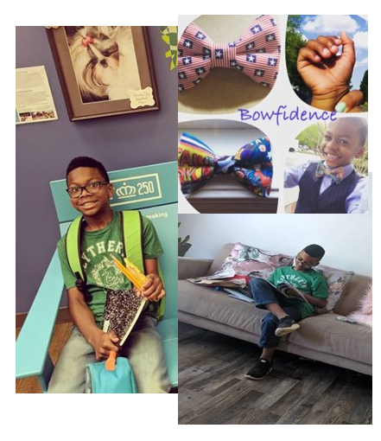
Accidental Homeschooler
Harrison's Story......
Moving forward beyond the diagnosis.
Notes:
Sunny

Slide 25
Benefits to homeschooling
Homeschool can be done without an IEP
You can partner with different agencies/therapist
You can discover your childs learning mode
Incorporate your beliefs, values and religion
Hands on experience of learning daily and all times
Notes:
Kim

Slide 26
Special Needs Homeschool Curriculum
Proceeds at the student's own pace
Builds on existing reading, writing and math skills.
Encourages kids to become active learners
Allows placement and progress at independent levels
Introduces new learning opportunities in a safe, supportive
environment
Balances learning with fun!
Notes:
Kim

Slide 27
What if I need an IEP?
IEP's are a guide or plan (doesn't define your child)
8 Components of an IEP
Annual Goals
Benchmarks or Short-Term Objectives.
Measuring and Reporting Progress
Special Education
Related Services
Supplementary Aids and Services
Program Modifications for School Personnel
Extent of Nonparticipation
Notes:
Sunny
The IEP, Individualized Education Program, is a written document that's developed for each public school child who is eligible for special education. The IEP is created through a team effort and reviewed at least once a year. Before an IEP can be written, your child must be eligible for special education
Key Takeaways
Your child needs an IEP to get special education services at school.
You play a key role throughout the IEP process.
It’s important to stay on top of your child’s IEP and make sure your child is making progress.

Slide 28
Write Your Own IEP/ School IEP
List
List your child's strengths and weaknesses (academic and behaviorial)
Gather
Gather Former Testing or Observations (school district, home testing, or tutoring)
Collaborate
Collaborate with therapist (they see what you can't)
Compile
Compile work samples (determine goals)
Notes:
Sunny

Slide 29
What is your experience with IEPs?
​1. We currently have an IEP.
2. We need additional information.
3. We are not planning to use an IEP.
4. We have chosen not to use an IEP.
Notes:
Kim

Slide 30
Empowering beyond diagnosis
Put them in the driver's seat
01
Trust that they know
02
Believe in them
03
Showcase their talent (Be You)
Be a Resource
04
Notes:
Sunny

Slide 31
Put them in the driver's seat
Super Negotiator
Does your kid disagree with everything you say, coming up instead with his/her own ideas and make you frustrated? Don’t worry, your kid may have the negotiation superpower above an average child!
Super Caring
Does your kid have empathy for others? Do they always run to help someone when they have fallen or hurt themselves? Your child might have the mighty super caring power!
Your child might be the next Mother Teresa!
Super Architect
Does your kid like to break things apart and put them together? Or does your child make something different out of the parts?
They may be the next great inventor or architect!
Have Patience. Nurture. Be Kind
Notes:
Sunny

Slide 32
Trust That They Know
"When kids know who they are, they naturally gravitate toward experiences in which learning and fun happen together." - Author Unknown
Notes:
Kim

Slide 33
Believe In Them...
Encourage them to connect with what excites and inspires them
Model language that enables your child to articulate their feelings and needs and gives children the freedom to learn without fear.
Kids naturally gravitate toward experiences in which learning, and fun happen together.
Curiosity, creativity and confidence are a natural mindset for kids that feel relaxed in themselves, and who can express themselves clearly.
Notes:
Kim

Slide 34
Building confidence
Building Confidence In Boys One Bowtie at a time....
Notes:
Sunny

Slide 35
Discover Superpower by Personality
Introvert
Extrovert
Ambivert
Notes:
Sunny

Slide 36
Introvert Learning
Learn from the inside outward
Present idea or activity in an engaging way
Allow space for children
Allow time for response (writing and drawing)
Slow and steady wins the race
Environment of calm, safety and trust
Source: Primotoyo
Notes:
Sunny

Slide 37
Extrovert Learning
Learn from the inside outward
-Allow your child to talk and share
-Create opportunities for active learning
-Limit distractions and clear instructions
-Consider rewards and competition
- Allow for independent discovery
Source: Primotoyo
Notes:
Sunny

Slide 38
Pause and Lean In
Notes:
Sunny

Slide 39
Do you know Your Child's Superpower?
​1. I am aware of my child's superpower.
2. We are discovering our child's superpower.
3. I have no clue of my child's superpower.
4. I have never thoought of a child's superpower.
Notes:
Kim

Slide 40
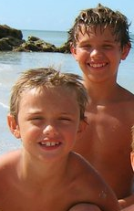
Kim's Story
Brendan: Dyslexia
Trevor: Cocktail Party Syndrome
Something isn't right, key indicators
The diagnosis
The journey
Notes:
Kim
Key indicators: Brendan not able to read but very articulate
Trevor very shy but loud in groups, turning tv up and not hearing sirens at parade
Doctors said with both that no test would have identified so my instincts were spot on
Brendan did not read until 6th grade but then did AP classes as a Junior in HS and straight As in college.
Trevor had to learn to how to navigate phone calls etc.. Dr said he would have probably had a very difficult time in a class
No IEPS; they do not support your child in life so they need to develop coping skills

Slide 41
Encourage Superpowers
Notes:
Kim

Slide 42
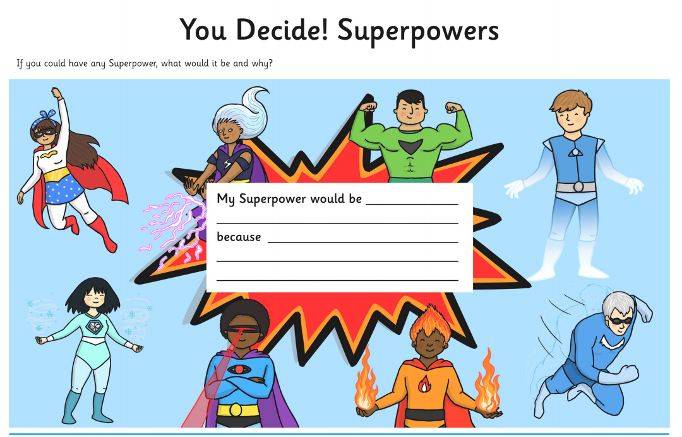
Start Now...
Notes:
Sunny

Slide 43
Books that Inspire...
Notes:
Sunny

Slide 44
Resources

Slide 45
COMING UP
Session 4: What about Socialization?
Finding Community Even if it is Virtual
Thur., Aug 27th at 10:00 am MT

Slide 46
What questions do you have?
Notes:
This is where I will field questions that come in on the Q&A feature.

Slide 47
Remember

Slide 48
Contact us
Questions?
Email us at WGUWebinars@wgu.edu
kimberly.dement@wgu.edu
sunny.jordan@wgu.edu
Notes:
This is where I will field questions that come in on the Q&A feature.

